Slide 1
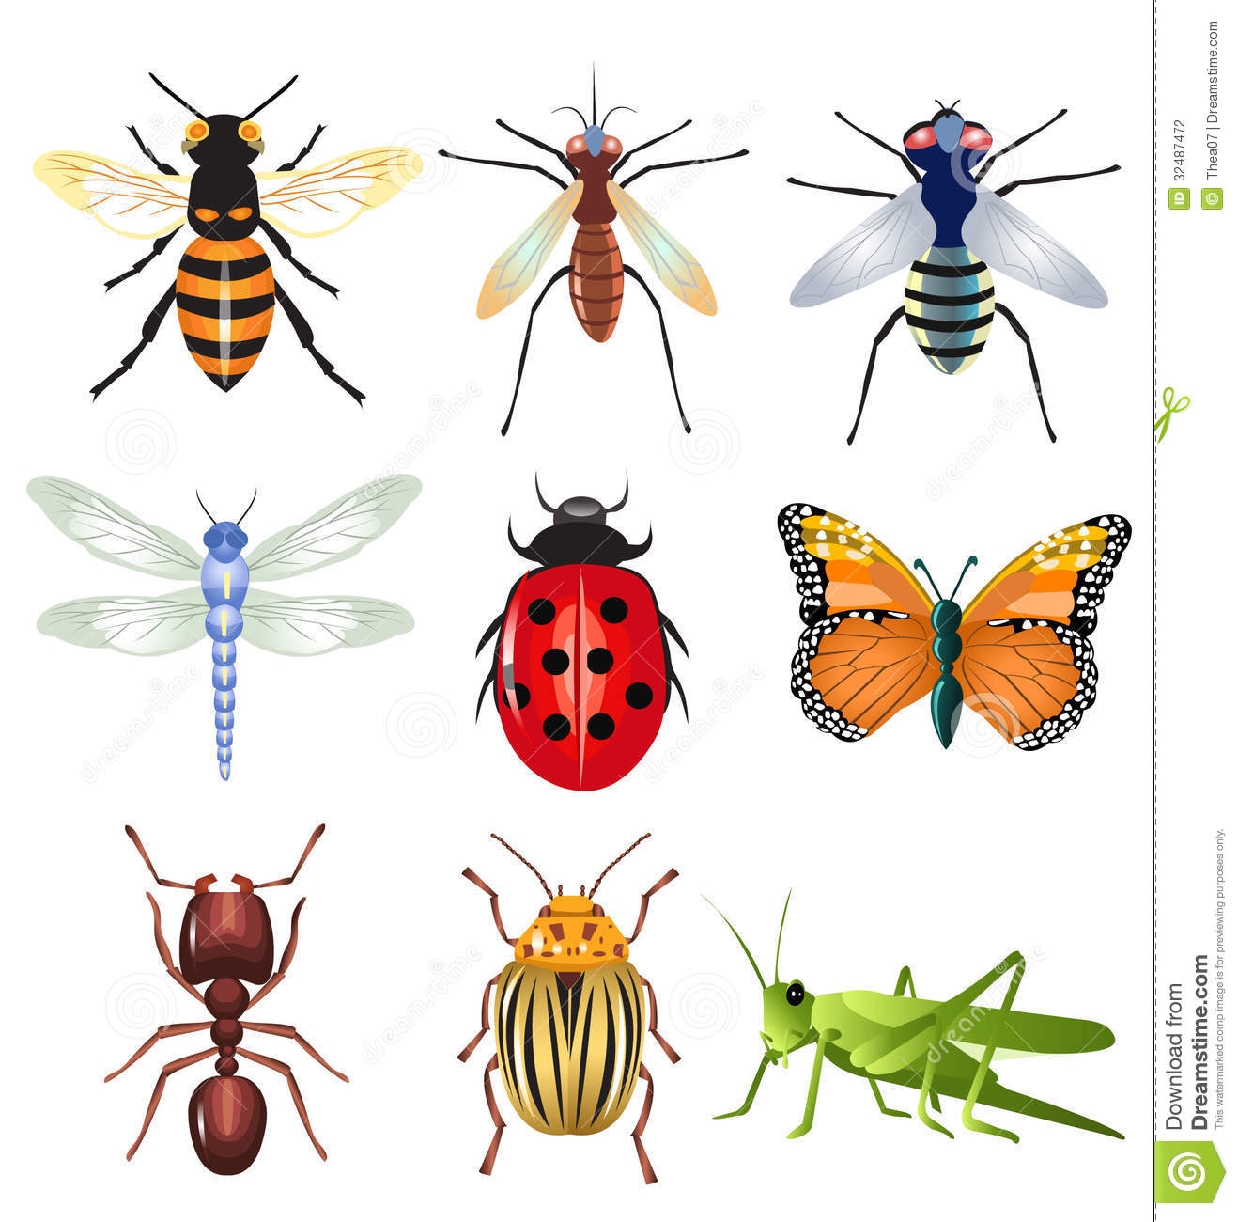
Insects
Kyra Szczesek

Slide 2
4 facts about insects
An insect’s body is segmented into 3 parts. (head, thorax, abdomen)
Insects Reproduce sexually
An insect’s Blood moves freely in their system (open circulatory system)
Insects get oxygen by openings on the sides of their abdomen.

Slide 3
Synthesis
Insects make their own proteins and build organic molecules inside their body.

Slide 4
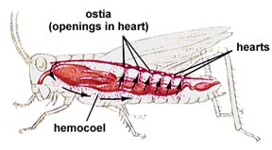
Transport
Insects have an open circulatory system, which means blood flows freely in their body.

Slide 5
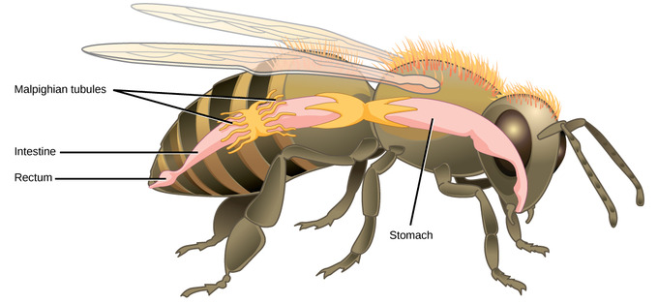
Excretion
Insects get rid of waste by using their digestive system. Their food moves through their body and exits through their anus.

Slide 6
Respiration
Insects get oxygen from openings on the sides of their abdomen, and they get energy from this oxygen.

Slide 7
Nutrition
Insects are heterotrophic, meaning they consume food.
They eat nectar blood, other organisms, and plants

Slide 8
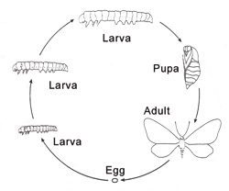
Growth
Insects are born as eggs, then throughout their life they grow through metamorphosis. metamorphosis is when their shape and form changes. 10% of insects go through incomplete metamorphosis

Slide 9
Regulation
Insects use hormones to communicate within their body and regulate it.

Slide 10
Reproduction
Insects reproduce sexually, meaning 2 insects are needed to make an offspring

